Slide 1
An Analysis Of Movie Success At The Box Office

Slide 2
Question 1
Question 2
Question 3
Is there a Correlation between Budget and Revenue?
Does Return on Investment vary by budget?
Is the performance of a film affected by the Month in which it is released?
Question 4
Question 5
Do Gross Revenue and ROI vary by the Genre
Are Runtime and Ratings correlated?

Slide 3
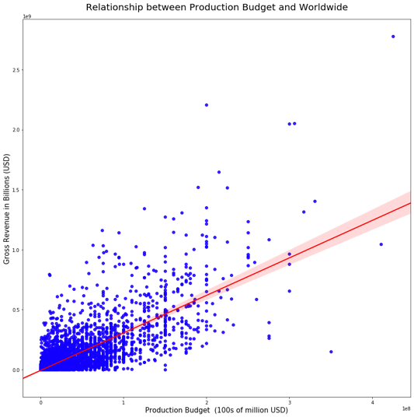
Is there a Correlation between Budget and Revenue?
Correlation Coefficient
0.7483
Recommendation:
These variables are highly interlinked
The higher the budget, the higher the gross revenue

Slide 4
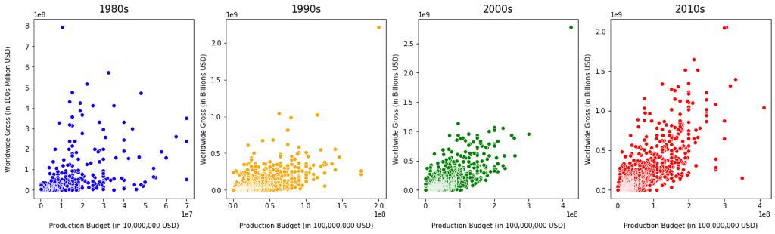
How has the correlation changed over the decades?
CORRELATION COEFFICIENTS
0.3604
0.5811
0.7579
0.7974

Slide 5
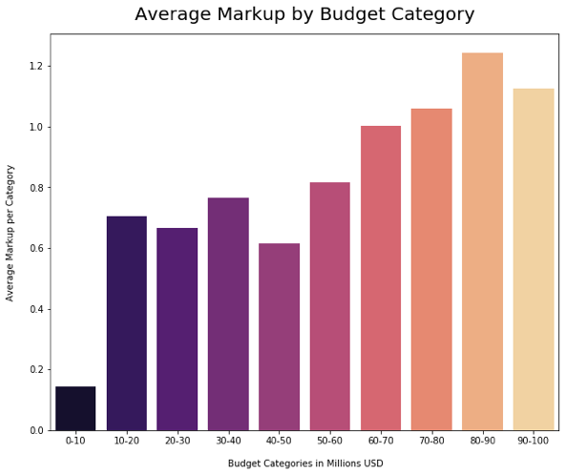
Does Return On Investment Vary By Budget?
93% of films have a budget under $100m
$80-90 million budget yields the highest return on investment

Slide 6
Is The Performance of a movie affected By the Month in Which it is Released?
Average Gross Revenue by
Release Month
July - $51m
November - $50m
June - $46m

Slide 7
Is there a trend indicating which month is best to release a movie?

Slide 8
Does Return on Investment vary by Genre?
Recommendations:
Animation
Adventure
Mystery

Slide 9
Distribution of the top 5 Genres by count

Slide 10
Is There a Correlation Between Ratings and Runtime?
CORRELATION COEFFICIENTS
0.2569
0.2097
0.7504

Slide 11
Future Analysis
Sorting Genres
Create a better way of sorting through genres, when movies have multiple genres to allow for more accurate analysis.
Crew effects
Explore the effects the movie crew can have on Revenue and ROI
Explore Netflix & Amazon Prime
How have they changed the game when it comes to movie production.
Explore the effects of ratings in more detail
Further analysis of the relationship between movie success and ratings

Slide 12
Thank
You

